Slide 1



Module 3: Cloud Infrastructure and Platforms in Industry

Slide 2
Outline
Why Data Center
Data Center- Servers
Basic DCN Architecture (3 tier)
Issues with traditional 3 tier architecture
What is WSD (Warehouse-Scale Data-Center)
Leaf Spine Architecture
Topologies in WSD
i. Fat-Tree topology
ii. BCube network

Slide 3
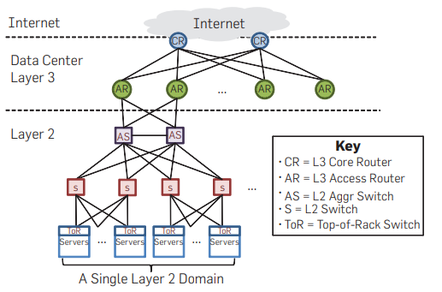
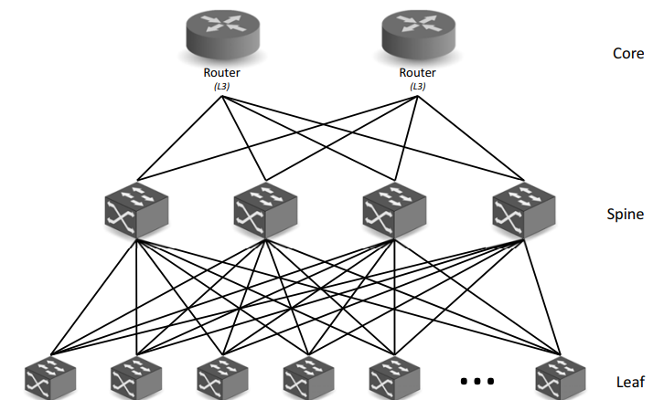
Data Center Network Evolution
3 TIER (tree) - oversubscription, looping
FAT TREE CLOS (no oversubscription, no looping)
Leaf Spine (strictly 2 tier)
Notes:
3 tier - 3 switches- access, aggregate, switch
2 tier - 2 switches- leaf, spine

Slide 4
Clos Topology
In a classic Clos network, all the racks on the left send data to the racks on the right.
In datacenters, racks can both send and receive data, so instead of having a separate layer of senders and recipients, we can have a single layer with all the racks (acting as either sender or recipient).
Then, data travels along one of the many paths deeper into the network, and then back out to reach the recipient. This result is called a folded Clos network, because we’ve “folded” the sender and recipient layers into one.
Notes:
In a 5:1 oversubscribed leaf, the aggregate server bandwidth is five times greater than the uplink capacity, meaning that if multiple servers transmit simultaneously at line rate, they must share the uplink bandwidth.”
At full load, five times more server bandwidth exists than uplink capacity.

Slide 5
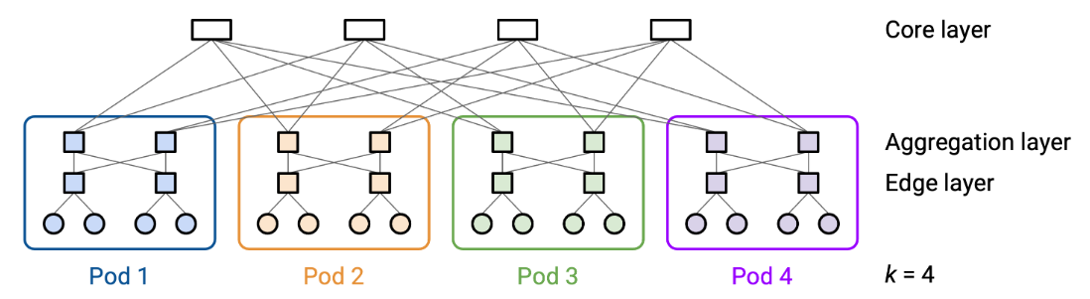
Fat Tree Clos
k-ary fat tree, we create k pods. Each pod has k switches.
Equal-cost paths

Slide 6
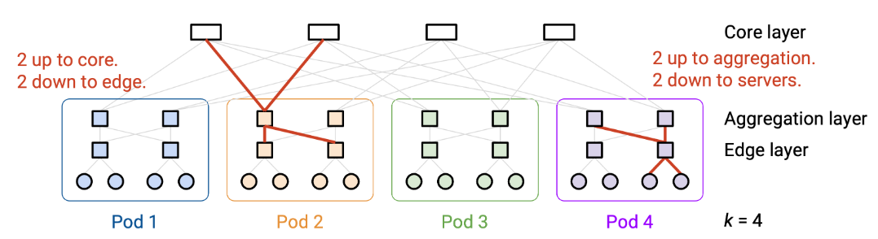
Fat Tree Clos
Each switch in the pod has k links. Half of the links (k/2) connect upwards, and the other half (k/2) connect downwards.
Total uplink bandwidth = total downlink bandwidth (Fat-tree stops unintended oversubscription; it only exists if the designer deliberately introduces it.)
Each core switch has k links, connecting to each of the k pods.

Slide 7
B Cube Network
BCube is a server-centric data center network topology proposed by Microsoft Research for modular data centers.
Servers participate in packet forwarding, not just switches.
BCube is especially designed for:
High fault tolerance
Horizontal scalability
Commodity (low-cost) switches
Traditional data center networks assume that switches do all routing and servers are end points only.
This lead to problems like: if switches fail, big outages happen
Notes:
CR - like which data center
AR- INside data center, which block or cluster the request should go to
AS and L2 switch, they will check source and destination MAC address
ToR swith- at top of every server

Slide 8
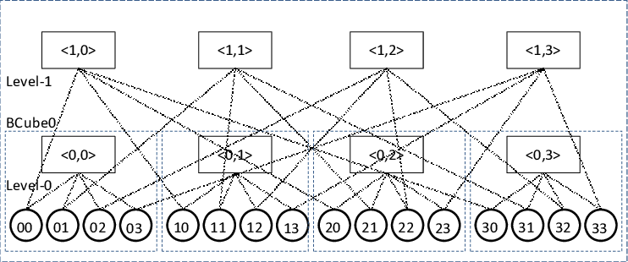
Basic Building Block: BCube₀
BCube₀ Structure has-
n servers
1 n-port switch
Each server connects to the switch using 1 NIC
Notes:
CR - like which data center
AR- INside data center, which block or cluster the request should go to
AS and L2 switch, they will check source and destination MAC address
ToR swith- at top of every server

Slide 9
BCube Topology
At each switch level, one address digit is fixed and the other varies.
Every Level 1 switch is connected to a server with same second digit
Notes:
CR - like which data center
AR- INside data center, which block or cluster the request should go to
AS and L2 switch, they will check source and destination MAC address
ToR swith- at top of every server

Slide 10
Basic Building Block: BCube₀
Notes:
CR - like which data center
AR- INside data center, which block or cluster the request should go to
AS and L2 switch, they will check source and destination MAC address
ToR swith- at top of every server

Slide 11
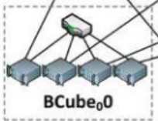
Recursive Construction: BCube₁, BCube₂, … BCubeₖ
Component | Formula
Number of servers | ( n^{k+1} )
Number of levels | ( k + 1 )
Switches per level | ( n^k )
NICs per server | ( k + 1 )
Case 1: n = 4, k = 0 → BCube₀ (1 Level)
Number of servers - n^{k+1} = 4^{0+1} = 4
Number of levels = k+1 = 0+1 = 1
Switches per level - n^k = 4^0 = 1
NICs per server = k+1 = 0+1 = 1
Notes:
CR - like which data center
AR- INside data center, which block or cluster the request should go to
AS and L2 switch, they will check source and destination MAC address
ToR swith- at top of every server

Slide 12
Recursive Construction: BCube₁, BCube₂, … BCubeₖ
Component | Formula
Number of servers | ( n^{k+1} )
Number of levels | ( k + 1 )
Switches per level | ( n^k )
NICs per server | ( k + 1 )
Case 2: n = 4, k = 1 → BCube₁ (2 levels)
Number of servers - n^{k+1} = 4^{1+1} = 16
Number of levels = 1+1 = 1+1 = 2
Switches per level - n^k = 4^1 = 4
NICs per server = k+1 = 1+1 = 2
Notes:
CR - like which data center
AR- INside data center, which block or cluster the request should go to
AS and L2 switch, they will check source and destination MAC address
ToR swith- at top of every server

Slide 13
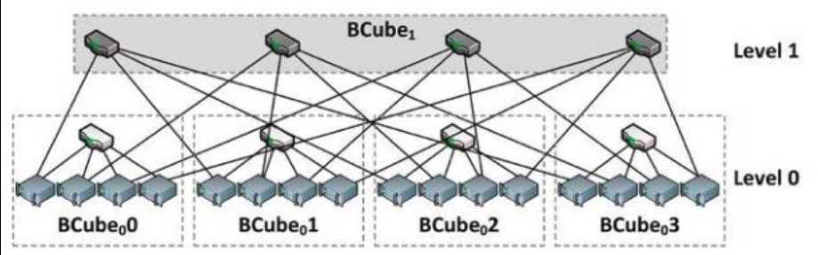
Recursive Construction: BCube₁, BCube₂, … BCubeₖ
Case 2: n = 4, k = 1 → BCube₁ (2 levels)
Number of servers - n^{k+1} = 4^{1+1} = 16
Number of levels = 1+1 = 1+1 = 2
Switches per level - n^k = 4^1 = 4
NICs per server = k+1 = 1+1 = 2

Slide 14
How uplink / downlink communication happens
01, wants to talk to 33
Setup
Node 01 means:
First digit = 0 → connected to Level-0 switch <0,0>
Second digit = 1 → connected to Level-1 switch <1,1>
Node 33 means:
First digit = 3 → connected to Level-0 switch <0,3>
Second digit = 3 → connected to Level-1 switch <1,3>

Slide 15
Recursive Construction: BCube₁, BCube₂, … BCubeₖ
BCube₁ is:
Built using n BCube₀ units
n switches at level-1
Each server now has 2 NICs:
NIC-0 → level-0 switch
NIC-1 → level-1 switch
Notes:
CR - like which data center
AR- INside data center, which block or cluster the request should go to
AS and L2 switch, they will check source and destination MAC address
ToR swith- at top of every server

Slide 16
How uplink / downlink communication happens
Path from 01 to 33
01 → Level-1 switch <1,1>
Node 01 uses its second digit (1) to connect directly to switch <1,1>.
Level-1 switch <1,1> → Node 31
Switch <1,1> connects to all nodes whose second digit is 1. That includes node 31 (address digits: 3 and 1).
Node 31 → Level-0 switch <0,3>
Node 31 is inside BCube0 <0,3>, so it connects to that local level-0 switch.
Level-0 switch <0,3> → Node 33
Finally, within BCube0 <0,3>, the level-0 switch connects node 31 to node 33.
Notes:
Total 4 hops

Slide 17
Where BCube Is Used (or Suitable)
BCube is ideal for:
Modular data centers
Cloud platforms with homogeneous servers
Environments where server reliability is high
Not ideal when:
Servers cannot forward packets
Legacy applications expect pure L2 networks
Notes:
Networks that primarily make use of MAC addresses for forwarding and ARP broadcasts

Slide 18
Knowledge Check
In a Fat-Tree topology, what is the primary advantage of using Clos network design?
A. It ensures full bisection bandwidth
B. It minimizes the number of switches required
C. It eliminates the need for core switches
D. It reduces the number of server ports
In BCube0, how are servers connected?
Each server connects to multiple switches
Servers are connected directly to each other
Each server connects to a single n-port switch
Servers connect only to core switches
Notes:
1 A, 2C

Slide 19
Knowledge Check
3. Which of the following best describes BCube1?
It adds a second layer of switches, giving each server two ports
It uses a ring topology for interconnection
It eliminates switches entirely
It connects servers only through level-0 switches
4. In a Fat-Tree topology with k-port switches, how many servers can be supported?
k^3 / 4
k^3
2k
k^2
Notes:
3 A, 4A

Slide 21
Knowledge Check
5. What is a key difference between Fat-Tree and BCube topologies?
Fat-Tree eliminates redundancy, BCube adds redundancy
Fat-Tree uses hierarchical switches, BCube uses recursive server-switch connections
Fat-Tree is server-centric, BCube is switch-centric
Fat-Tree supports fewer servers than BCube
6. In a 2‑level BCube (BCube1), what does the two‑digit server address represent?
A) The rack number and the server’s MAC address
B) The level‑0 switch ID and the level‑1 switch ID the server connects to
C) The IP subnet and the physical port number
D) The server’s position in the Fat‑Tree hierarchy
Notes:
5B,6B

Slide 22
Knowledge Check
7. Why is BCube considered server-centric?
Servers are connected only through core switches
Servers are directly connected to multiple levels of switches
Switches form the hierarchy and servers only connect at the edge
Servers act as routers for each other
8. In a 2‑level BCube (BCube1), if server 23 wants to communicate with server 10, what is the path taken ?
Ans:
Notes:
7- B, D

